Slide 1
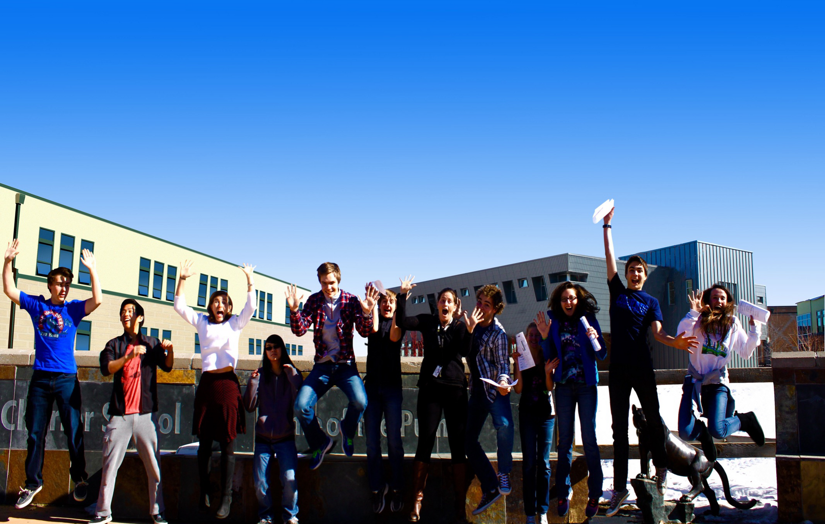
Strengths

Slide 2
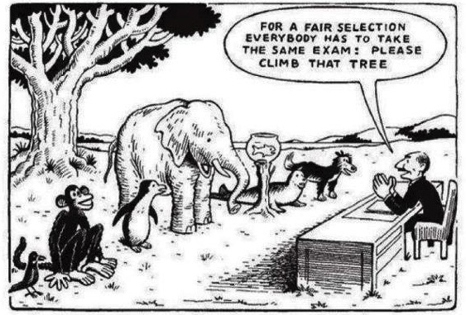
Our Core Belief and Mission at Indigo

Slide 3
INDIGO REPORT COMPONENTS

Slide 4
Use these skills most.
Behavioral/ Communication Style. What styles do you struggle with?
Are you leveraging your strengths?
How do you contribute to your teaching teams?
#1 and #2 Motivator on your list are critical for personal fulfillment.
#6 may be important to avoid.

Slide 6
Share a strength/value to a team that you resonate with.

Slide 7
Contact Information
www.indigoedco.com
sueann.casey@indigoproject.org
www.linkedin.com/in/sueann-casey-indigo
509-435-5903

