Slide 1
Skills

Slide 2
Use these skills most.

Slide 3
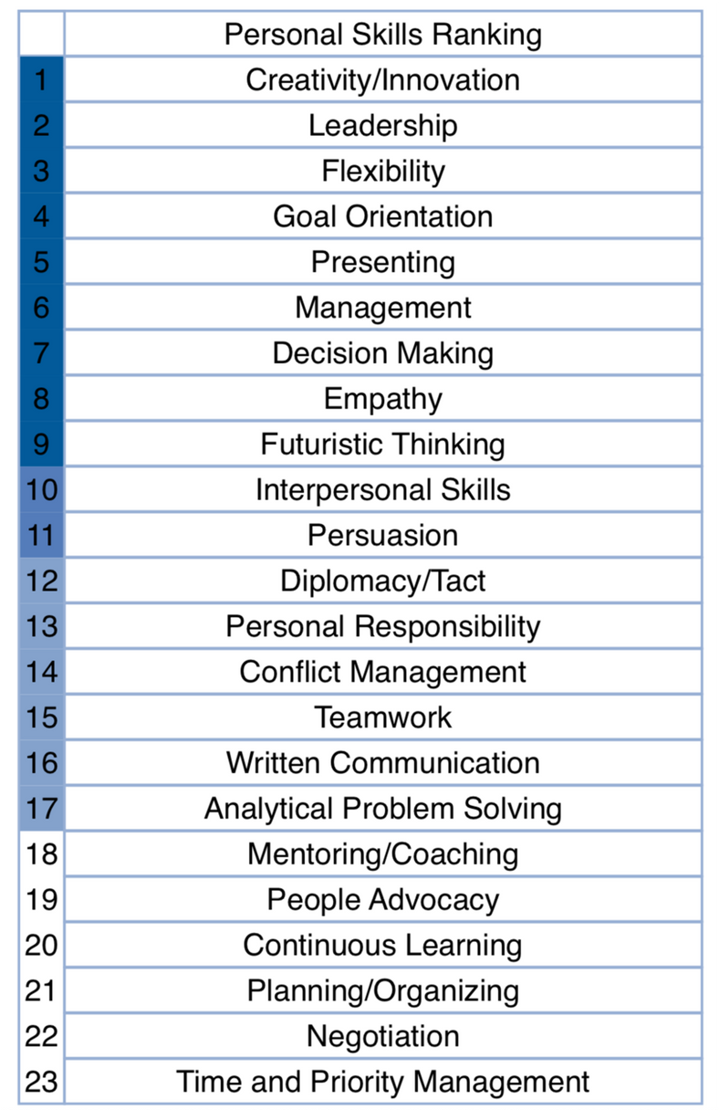
focus on Top 5 Skills
LESS Energy
Skills are learned.
Some are naturally
easier/harder for you
and…
Brain science proves
you can learn any skill!
MORE Energy

Slide 4
PARETO PRINCIPLE

Slide 5
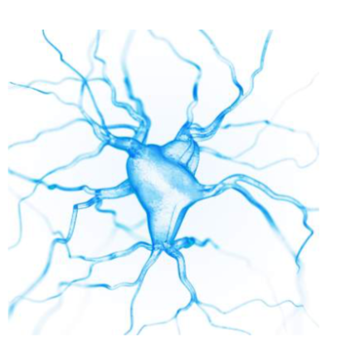
BRAIN SCIENCE OF LEARNING
Our brains are made up of Neurons aka nerve cells and these are the key to learning and retaining knowledge.
Dendrites extend off the cell body. The more we learn about this subject, the more dendrites we develop.
New dendrites connect to Axions of other neurons allowing you to learn something new.
In order to learn something new, we must first start with something we already know and reach out those dendrites to connect to a new idea, concept, skill, etc.

Slide 6
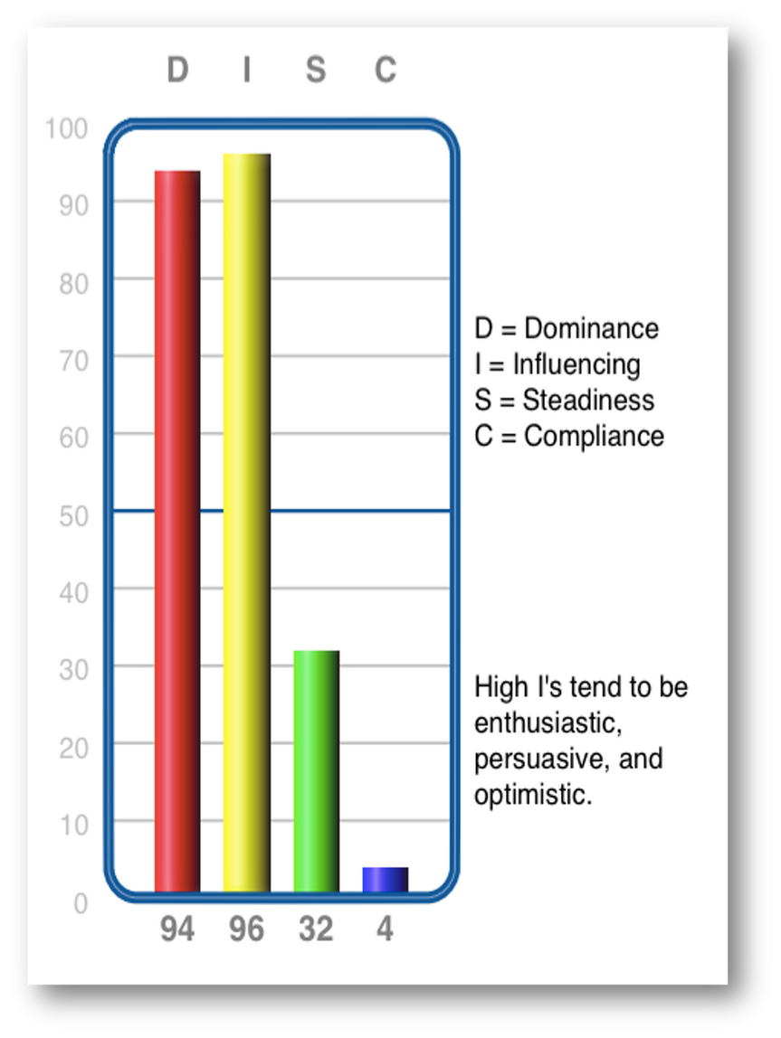
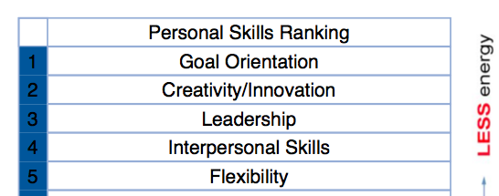
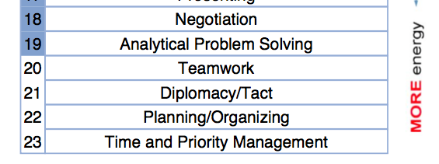
Relationship between Skills and DISC
Consider these graphs.
• What connections do you see between DISC and the top 5 skills?
• What connections do you see between DISC and the bottom 5 skills?
• How can we use the top skills to develop any of the bottom skills?

Slide 7
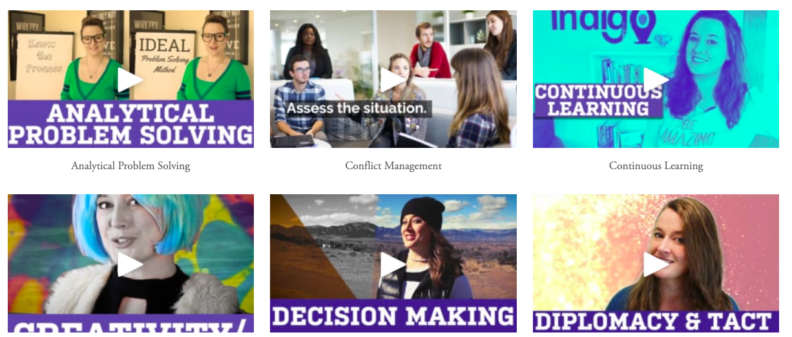
www.IndigoSkills.com
For further explanation of Indigo skills, visit this webpage. Download the Skills Guide and watch short videos to enhance your understanding.

Slide 8
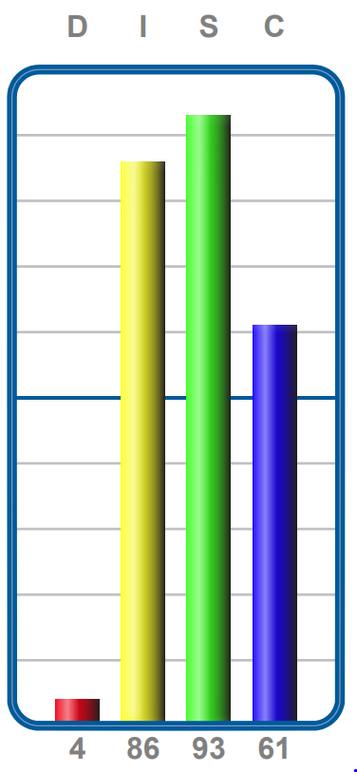
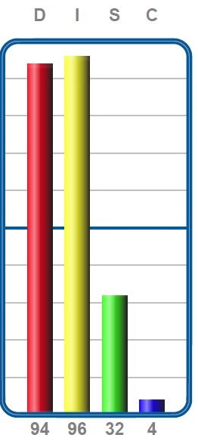
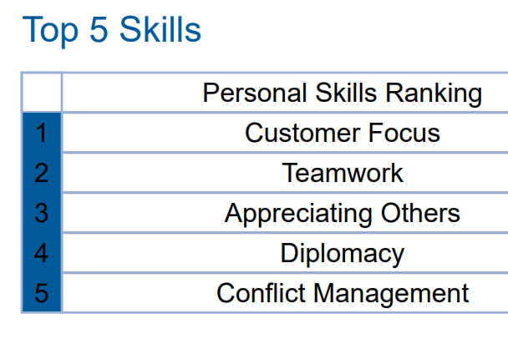
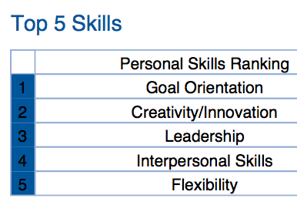
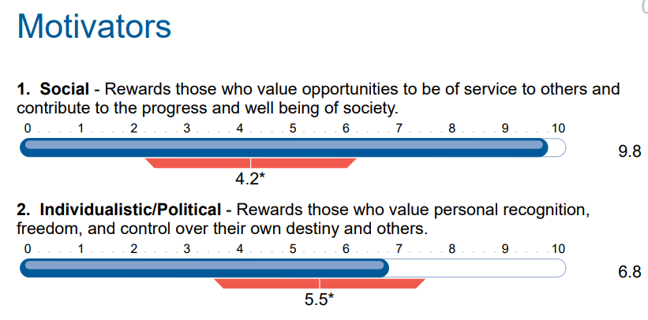
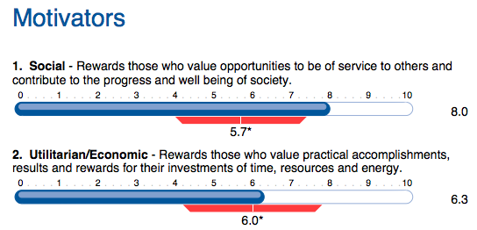
Sueann Casey – Founding Member
Chief Customer Experience Officer
Sheri Smith – Founder
Chief Executive Officer

Slide 9
Q&A

Slide 10
Contact Information
www.indigoedco.com
sueann.casey@indigoproject.org
www.linkedin.com/in/sueann-casey-indigo
509-435-5903

