Slide 1
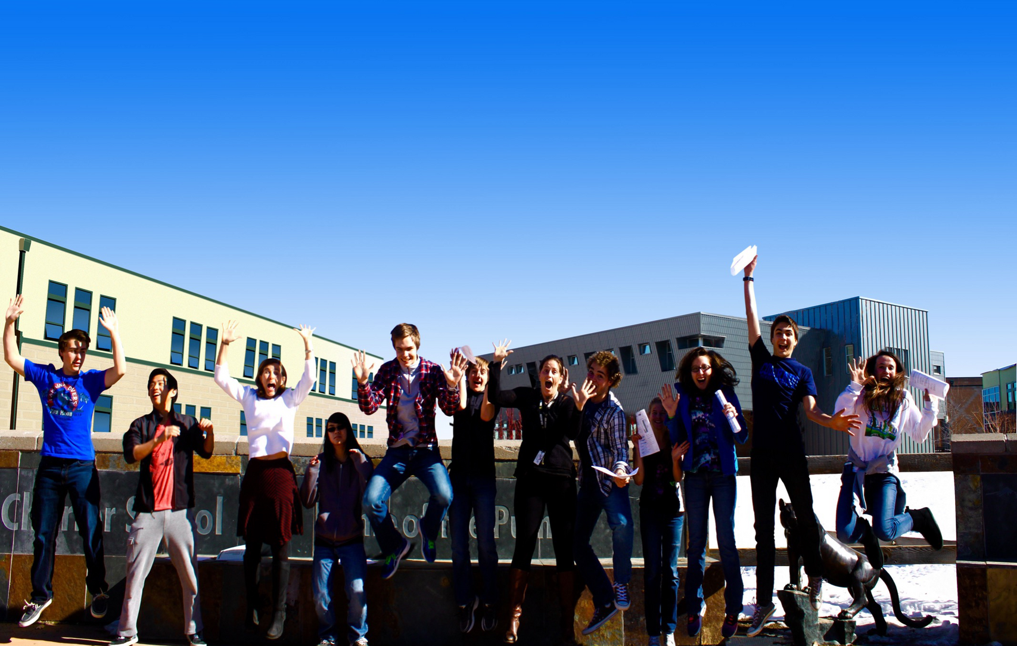
Motivators

Slide 2
#1 and #2 Motivator on your list are critical for personal fulfillment.
#6 may be important to avoid.

Slide 3
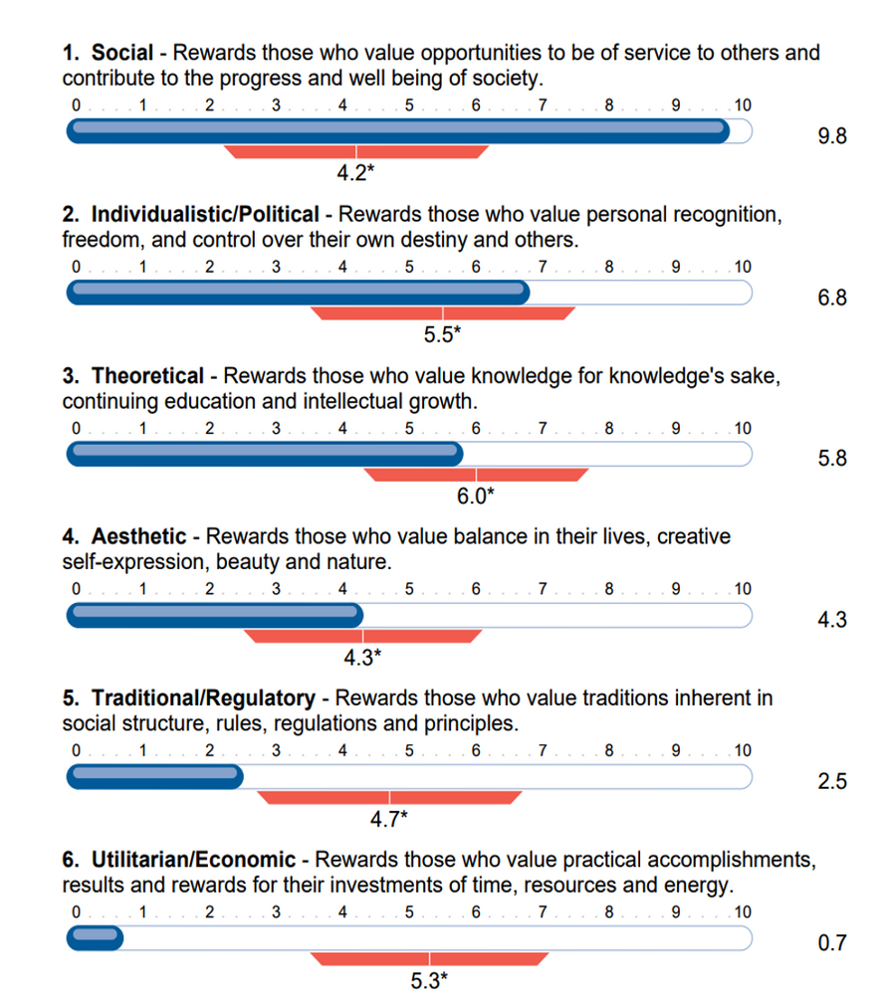
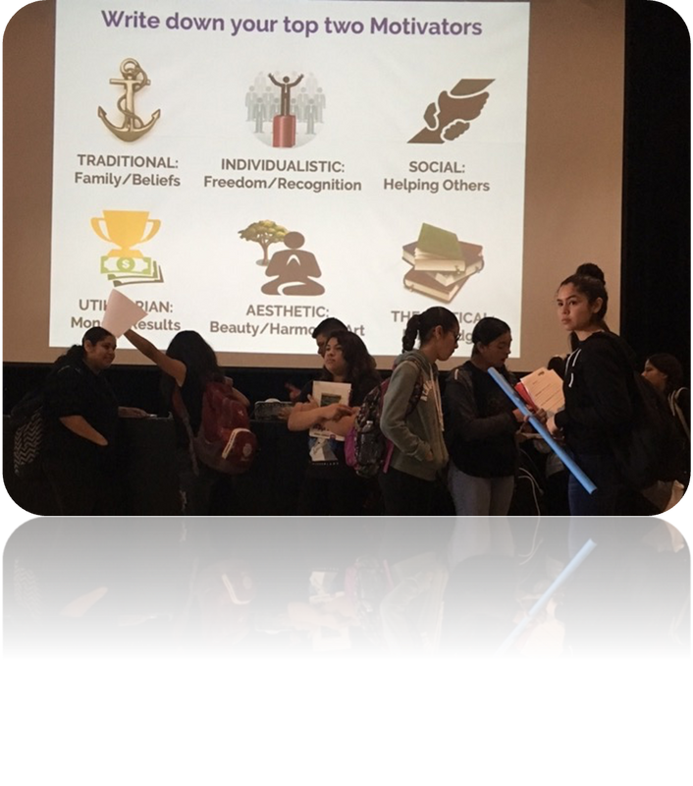
Motivators
Motivators represent your deepest motivations and “driving forces”.
Students exploring their motivators in East LA.

Slide 4
Intrinsic vs. Extrinsic Motivation

Slide 6
How do your TOP 2 motivators combine and show up for you?
TRADITIONAL
INDIVIDUALISTIC
SOCIAL
Beliefs, Values, Family
Independence, Freedom, Choice
Helping Others, Making a Difference, Impact
UTILITARIAN
AESTHETIC
THEORETICAL
Efficient, Money, Practical
Art, Beauty, Music, Nature, Harmony
Knowledge, Truth, Learning

Slide 7
CAREERS AND MAJOR BRAINSTORM
TRADITIONAL
INDIVIDUALISTIC
SOCIAL
Beliefs, Values, Family
Independence, Freedom, Choice
Helping Others, Making a Difference, Impact
UTILITARIAN
AESTHETIC
THEORETICAL
Efficient, Money, Practical
Art, Beauty, Music, Nature, Harmony
Knowledge, Truth, Learning

Slide 8
IN BETWEEN ACTIVITY
Motivator Statement: Considering your top 2 motivators, how would you describe your "why"? What is most important to you? What do you value?
Motivator Examples by Industry: For each industry below, try to come up with at least one job within that industry that would be appealing to each motivator.
• The Healthcare/Medical Field
• The Justice/Law Field
Other jobs by motivators: For each motivator, try to think of a few jobs or even companies that someone with each motivator could be interested in.

Slide 9
Q&A

Slide 10
Contact Information
www.indigoedco.com
sueann.casey@indigoproject.org
www.linkedin.com/in/sueann-casey-indigo
509-435-5903

